Slide 1
C Programming Language

Slide 2
Introduction:
C programming is a popular computer programming language which is widely used for system and application software. Despite being fairly old programming language, C programming is widely used because of its efficiency and control.

Slide 3
C Programming: Keywords and Identifiers
Character set
Character set are the set of alphabets, letters and some special characters that are valid in C language.
Alphabets:
Uppercase: A B C .................................... X Y Z
Lowercase: a b c ...................................... x y z

Slide 4
C Programming: Keywords and Identifiers
Keywords:
Keywords are the reserved words used in programming. Each keywords has fixed meaning and that cannot be changed by user.
Keywords in C Language: auto, double, int, struct, break, else, long, switch, case, enum, register, typedef, char, extern, return, union, continue, for, signed, void, do, if, static
while, default, goto, sizeof, volatile, const, float, short, unsigned

Slide 5
C Programming:Keywords and Identifiers
Identifiers:
In C programming, identifiers are created to give unique names to C entities to identify it during the execution of program. For example:
int money; //money is a identifier which denotes a variable of type integer.
int mango_tree; //mango_tree is another identifier, which denotes another variable of type integer

Slide 6
C Programming: Keywords and Identifiers
Rules for writing identifiers
An identifier can be composed of letters (both uppercase and lowercase letters), digits and underscore '_' only.
There is no rule for the length of an identifier. However, the first 31 characters of an identifier are discriminated by the compiler. So, the first 31 letters of two identifiers in a program should be different.

Slide 7
C Programming: Variables
Variables are memory location in computer's memory to store data. To indicate the memory location, each variable should be given a unique name called identifier. Variable names are just the symbolic representation of a memory location.
Examples of variable name: sum, car_no, count etc.
int num; // num is a variable of integer type.

Slide 8
C Programming: Data types in C
Fundamental Data Types : Integer types ,Floating Type,Character types
Derived Data Types: Arrays,Pointers,Structures,Enumeration
Syntax for declaration of a variable
data_type variable_name;

Slide 9
C Programming: Data types in C
Integer data types: int var1;
Floating types: float var2; double var3;
Character types: char var4='h';
The size of char is 1 byte. The character data type consists of ASCII characters. Each character is given a specific value. For example:
For, 'a', value =97 For, 'b', value=98 For, 'A', value=65 For, '&', value=33 For, '2', value=49
Here is the list of all ASCII characters in C language.

Slide 10
C Programming: Input/Output
Functions printf() and scanf() are the most commonly used to display and receive respectively. Let us consider an example:
#include <stdio.h> //This is needed to run printf() function. int main() { printf("C Programming"); //displays the content inside quotation return 0; }
Output: C Programming

Slide 11
C Programming: Input/Output
Explanation of How this program works
Every program starts from main() function.
printf() is a library function to display output which only works if #include<stdio.h>is included at the beginning.
Here, stdio.h is a header file (standard input output header file) and #include is the command to paste the code from the header file when necessary. When compiler encounters printf()function and doesn't find stdio.h header file, compiler shows error.
Code return 0; indicates the end of program. You can ignore this statement but, it is good programming practice to use return 0;.

Slide 12
C Programming: Input/Output
I/O of integers in C
#include<stdio.h> int main() { int c=5; printf("Number=%d",c); return 0; }
Output: Number=5

Slide 13
C Programming: Input/Output
#include<stdio.h> int main() { int c; printf("Enter a number\n"); scanf("%d",&c); printf("Number=%d",c); return 0; }
Output: Enter a number 4 Number=4
The scanf() function is used to receive an input from the user. In this program, the user is asked a input and value is stored in variable c. Note the '&' sign before c. &c denotes the address of c and value is stored in that address.

Slide 14
C Programming: Input/Output
I/O of floats in C
#include <stdio.h> int main(){ float a; printf("Enter value: "); scanf("%f",&a); printf("Value=%f",a); //%f is used for floats instead of %d return 0; }
Output
Enter value: 23.45 Value=23.450000

Slide 15
C Programming: Input/Output
I/O of characters and ASCII code
#include <stdio.h> int main(){ char var1; printf("Enter character: "); scanf("%c",&var1); printf("You entered %c.",var1); return 0; }
Output
Enter character: g You entered g.

Slide 16
C Programming: Input/Output
ASCII code: When a character is typed in the program below, the character itself is not recorded as a numeric value, the (ASCII value) is stored instead. And then, we display that value by using "%c",so that character is displayed.
#include <stdio.h> int main(){ char var1; printf("Enter character: "); scanf("%c",&var1); printf("You entered %c.\n",var1);
printf("ASCII value of %d",var1); return 0; }
Output
Enter character: g 103

Slide 17
C Programming: Operators
Arithmetic Operators
Operator | Meaning of Operator
+ | addition or unary plus
- | subtraction or unary minus
* | multiplication
/ | division
% | remainder after division( modulo division)

Slide 18
C Programming: Operators
Example of arithmetic operators
#include <stdio.h> int main(){ int a=9,b=4,c; c=a+b; printf("a+b=%d\n",c); c=a-b; printf("a-b=%d\n",c); c=a*b; printf("a*b=%d\n",c); c=a/b; printf("a/b=%d\n",c);
c=a%b; printf("Remainder when a divided by b=%d\n",c); return 0; }
a+b=13 a-b=5 a*b=36 a/b=2 Remainder when a divided by b=1

Slide 19
C Programming: Add two integers
/*C programming source code to add and display the sum of two integers entered by user */ #include <stdio.h> int main( ) { int num1, num2, sum; printf("Enter two integers: "); scanf("%d %d",&num1,&num2); /* Stores the two integer entered by user in variable num1 and num2 */ sum=num1+num2; /* Performs addition and stores it in variable sum */ printf("Sum: %d",sum); /* Displays sum */ return 0; }

Slide 20
C Programming: Multiply two Floating Numbers
/*C program to multiply and display the product of two floating point numbers entered by user. */ #include <stdio.h> int main( ){ float num1, num2, product; printf("Enter two numbers: "); scanf("%f %f",&num1,&num2); /* Stores the two floating point numbers entered by user in variable num1 and num2 respectively */ product = num1*num2; /* Performs multiplication and stores it */ printf("Product: %f",product); return 0;}

Slide 21
C Programming: Find ASCII Value of a Character
/* Source code to find ASCII value of a character entered by user */ #include <stdio.h> int main(){ char c; printf("Enter a character: "); scanf("%c",&c); /* Takes a character from user */ printf("ASCII value of %c = %d",c,c); return 0; }

Slide 22
C Programming: Relational Operators
Relational operators check the relationship between two operands. If the relation is true, it returns value 1 and if the relation is false, it returns value 0. For example:
a>b Here, > is a relational operator. If a is greater than b, a>b returns 1 if not then, it returns 0.
Operator | Meaning of Operator | Example
== | Equal to | 5==3 returns false (0)
> | Greater than | 5>3 returns true (1)
< | Less than | 5<3 returns false (0)
!= | Not equal to | 5!=3 returns true(1)
>= | Greater than or equal to | 5>=3 returns true (1)
<= | Less than or equal to | 5<=3 return false (0)

Slide 23
C Programming: Logical Operators
Logical operators are used to combine expressions containing relation operators. In C, there are 3 logical operators:
Operator | Meaning of Operator | Example
&& | Logial AND | If c=5 and d=2 then,((c==5) && (d>5)) returns false.
|| | Logical OR | If c=5 and d=2 then, ((c==5) || (d>5)) returns true.
! | Logical NOT | If c=5 then, !(c==5) returns false.

Slide 24
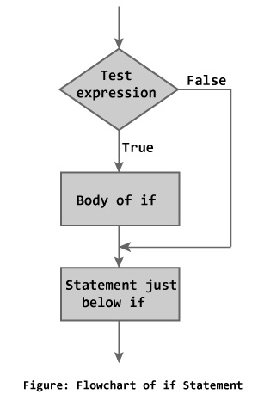
C Programming: if, if..else Statement
If statement
The if statement checks whether the text expression inside parenthesis () is true or not. If the test expression is true, statement/s inside the body of if statement is executed but if test is false, statement/s inside body of if is ignored.

Slide 25
C Programming: if, if..else Statement
Example 1: C if statement
Write a C program to print the number entered by user only if the number entered is negative.
#include <stdio.h> int main(){ int num; printf("Enter a number to check.\n"); scanf("%d",&num); if (num<0) { /* checking whether number is less than 0 or not. */ printf("Number = %d\n",num); } /*If test condition is true, statement above will be executed, otherwise it will not be executed */ printf("The if statement in C programming is easy."); return 0; }
Output:
Enter a number to check. -2 Number = -2 The if statement in C programming is easy.

Slide 26
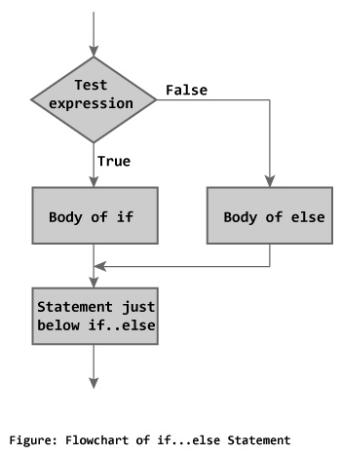
C Programming: if, if..else Statement
If else statement
C if...else statement: The if...else statement is used if the programmer wants to execute some statement/s when the test expression is true and execute some other statement/s if the test expression is false.

Slide 27
C Programming: if, if..else Statement
Example 2: C if...else statement
Write a C program to check whether a number entered by user is even or odd
#include <stdio.h> int main(){ int num; printf("Enter a number you want to check.\n"); scanf("%d",&num); if((num%2)==0) //checking whether remainder is 0 or not. printf("%d is even.",num); else printf("%d is odd.",num); return 0; }
Output:
Enter a number you want to check. 25 25 is odd.

Slide 28
C Programming: if, if..else Statement
1.-C Program to Check Whether a Number is Even or Odd
2.-C Program to Check Whether a Character is Vowel or consonant
3.-C Program to Find the Largest Number Among Three Numbers Entered by User
4.-C program to Find all Roots of a Quadratic equation
5.-C Program to Check Whether the Entered Year is Leap Year or not
6.-C Program to Check Whether a Number is Positive or Negative or Zero.
7.-C Program to Checker Whether a Character is an Alphabet or not

Slide 29
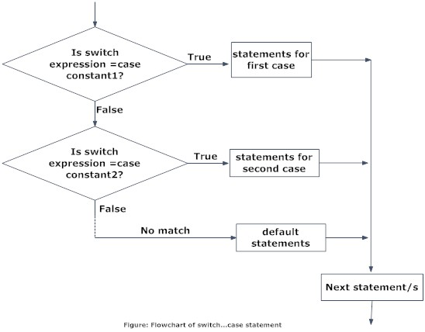
C Programming: switch Statement
Decision making is needed when, the program encounters the situation to choose a particular statement among many statements. If a programmer has to choose one block of statements among many alternatives, nested if...else can be used but, this makes programming logic complex. This type of problem can be handled in C programming using a switch statement.

Slide 30
C Programming: switch
Example :Write a program that asks user an arithmetic operator('+','-','*' or '/') and two operands and perform the corresponding calculation on the operands.
# include <stdio.h> int main() { char o;float num1,num2; printf("Select an operator either + or - or * or / \n"); scanf("%c",&o); printf("Enter two operands: "); scanf("%f%f",&num1,&num2); switch(o) { case '+': printf("%.1f + %.1f = %.1f",num1, num2, num1+num2); break;
case '-': printf("%.1f - %.1f = %.1f",num1, num2, num1-num2); break; case '*': printf("%.1f * %.1f = %.1f",num1, num2, num1*num2); break;

Slide 31
C Programming: switch
case '/': printf("%.1f / %.1f = %.1f",num1, num2, num1/num2); default: /* If operator is other than +, -, * or /, error message is shown */ printf("Error! operator is not correct"); break; } return 0; }
Enter operator either + or - or * or / * Enter two operands: 2.3 4.5 2.3 * 4.5 = 10.3
The break statement at the end of each case cause switch statement to exit. If break statement is not used, all statements below that case statement are also executed.

Slide 32
C Programming: Switch Statement
1.-Write a C program to check whether an alphabet is vowel or consonant using switch case.
2.-Write a C program to print day of week name using switch case.
3.-Write a C program print total number of days in a month using switch case.
4.-Write a C program to find maximum between two numbers using switch case.
5.-Write a C program to check whether a number is even or odd using switch case.
6.-Write a C program to create Simple Calculator using switch case.

Slide 33
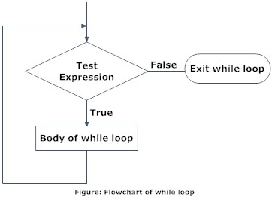
C programming loops:While
The while loop checks whether the test expression is true or not. If it is true, code/s inside the body of while loop is executed,that is, code/s inside the braces { } are executed. Then again the test expression is checked whether test expression is true or not. This process continues until the test expression becomes false..

Slide 34
C Programming: while
Example :Write a C program to find the factorial of a number, where the number is entered by user. (Hints: factorial of n = 1*2*3*...*n
/*C program to demonstrate the working of while loop*/ #include <stdio.h> int main(){ int number,factorial; printf("Enter a number.\n"); scanf("%d",&number); factorial=1; while (number>0){ /* while loop continues until test condition number>0 is true */ factorial=factorial*number; --number;} printf("Factorial=%d",factorial); return 0; }
}
Output:
Enter a number. 5 Factorial=120

Slide 35
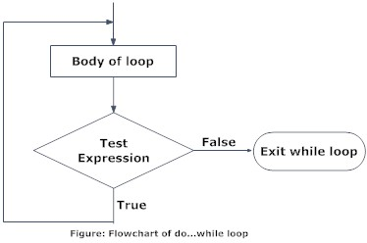
C programming loops:do-while
In C, do...while loop is very similar to while loop. Only difference between these two loops is that, in while loops, test expression is checked at first but, in do...while loop code is executed at first then the condition is checked. So, the code are executed at least once in do...while loops.

Slide 36
C Programming: do-while
Example :Write a C program to add all the numbers entered by a user until user enters 0.
/*C program to demonstrate the working of do...while statement*/ #include <stdio.h> int main(){ int sum=0,num; do /* Codes inside the body of do...while loops are at least executed once. */ { printf("Enter a number\n"); scanf("%d",&num); sum+=num; } while(num!=0); printf("sum=%d",sum); return 0; }
Output:
Enter a number 3 Enter a number -2 Enter a number 0 sum=1

Slide 37
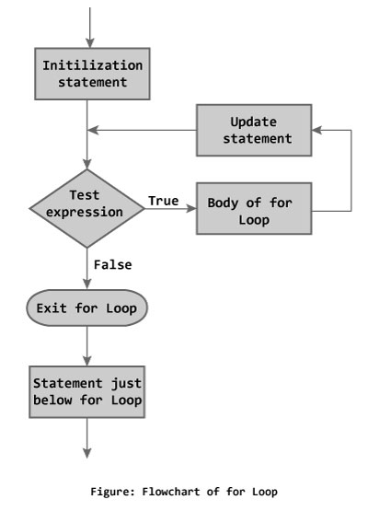
C programming loops:for
g.
The initialization statement is executed only once at the beginning of the for loop. Then the test expression is checked by the program. If the test expression is false, for loop is terminated. But if test expression is true then the code/s inside body of for loop is executed and then update expression is updated. This process repeats until test expression is false.

Slide 38
C Programming: for
Example :Write a program to find the sum of first n natural numbers where n is entered by user. Note: 1,2,3... are called natural numbers.
#include <stdio.h> int main(){ int n, count, sum=0; printf("Enter the value of n.\n"); scanf("%d",&n); for(count=1;count<=n;++count) //for loop terminates if count>n { sum+=count; /* this statement is equivalent to sum=sum+count */ } printf("Sum=%d",sum); return 0; }
Output:
Enter the value of n. 19 Sum=190

Slide 39
C Programming: while, do-while, for
1.-C Program to Find Sum of Natural Numbers
2.-C Program to Find Factorial of a Number
3.-C program to Generate Multiplication Table
4.-C Program to Display Fibonacci Series
5.-C Program to Find HCF of two Numbers
6.-C Program to Find LCM of two numbers entered by user
7.-C Program to Count Number of Digits of an Integer
8.-C Program to Reverse a Number
9.-C program to Calculate the Power of a Number
10.-C Program to Check Whether a Number is Palindrome or Not
11.-C Program to Check Whether a Number is Prime or Not
12.-C Program to Display Prime Numbers Between Two Intervals
13.-C program to Check Armstrong Number
14.-C Program to Display Armstrong Number Between Two Intervals
15.-C program to Display Factors of a Number

Slide 40
Functions in C
A function is a block of statements that performs a specific task.
Let’s say you are writing a C program and you need to perform a same task in that program more than once. In such case you have two options:
a) Use the same set of statements every time you want to perform the task
b) Create a function to perform that task, and just call it every time you need to perform that task.
Using option (b) is a good practice and a good programmer always uses functions while writing code in C.

Slide 41
Functions in C
Why we need functions in C
Functions are used because of following reasons –
a) To improve the readability of code.
b) Improves the reusability of the code, same function can be used in any program rather than writing the same code from scratch.
c) Debugging of the code would be easier if you use functions, as errors are easy to be traced.
d) Reduces the size of the code, duplicate set of statements are replaced by function calls.

Slide 42
Functions in C
Types of functions
1) Predefined standard library functions
Standard library functions are also known as built-in functions. Functions such as puts(), gets(), printf(), scanf() etc are standard library functions. These functions are already defined in header files (files with .h extensions are called header files such as stdio.h), so we just call them whenever there is a need to use them.
For example, printf() function is defined in <stdio.h> header file so in order to use the printf() function, we need to include the <stdio.h> header file in our program using #include <stdio.h>.

Slide 43
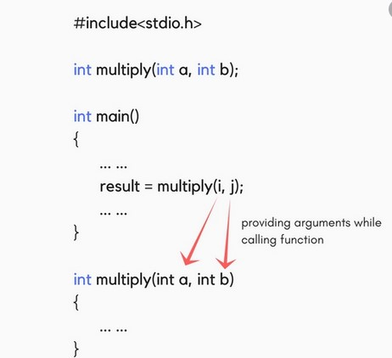
Functions in C
2) User Defined functions
The functions that we create in a program are known
as user defined functions or in other words you can say
that a function created by user is known as user defined
function.
Now we will learn how to create user defined functions
and how to use them in C Programming

Slide 44
C Programming: Pointers in C
What is a Pointer?
A pointer is a variable which contains the address in memory of another variable. We can have a pointer to any variable type.
The unary or monadic operator & gives the ``address of a variable''.
The indirection or dereference operator * gives the ``contents of an object pointed to by a pointer''.
To declare a pointer to a variable do:
int *pointer;

Slide 45
C Programming: Pointers in C
Consider the effect of the following code:
int x = 1, y = 2;
int *ip;
ip = &x;
y = *ip;
x = ip;
*ip = 3;
It is worth considering what is going on at the machine level in memory to fully understand how pointer work.
Assume for the sake of this discussion that variable x resides at memory location 100, y at 200 and ip at 1000. Note A pointer is a variable and thus its values need to be stored somewhere. It is the nature of the pointers value that is new.

Slide 46
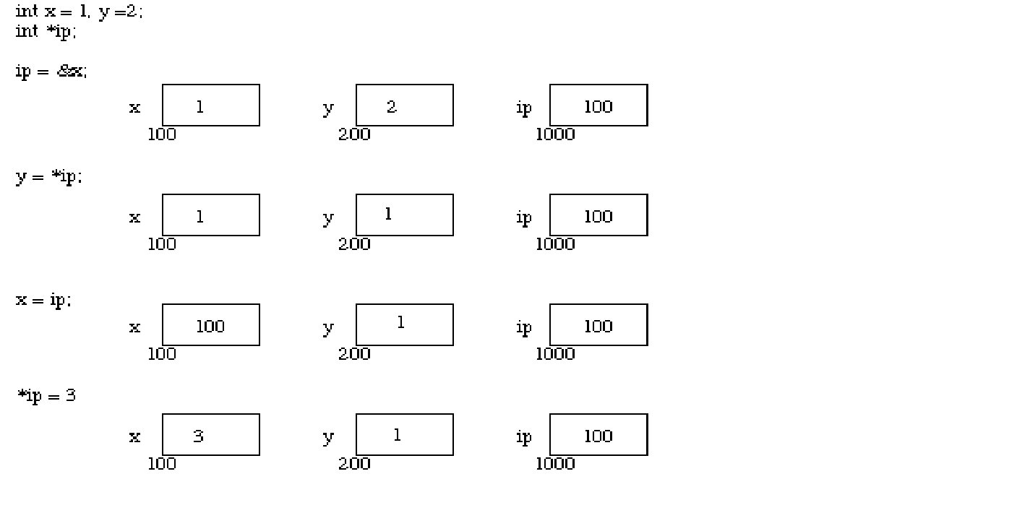
C Programming: Pointers in C

Slide 47
C Programming: Pointers in C
Pointer, Variables and Memory
Now the assignments x = 1 and y = 2 obviously load these values into the variables.
ip is declared to be a pointer to an integer and is assigned to the address of x (&x). So ip gets loaded with the value 100.
Next y gets assigned to the contents of ip. In this example ip currently points to memory location 100 -- the location of x. So y gets assigned to the values of x -- which is 1.

